Slide 1


Slide 2

The Directive Principles of State Policy, embodied in Part IV of the constitution, are directions given to the central and state governments to guide the establishment of a just society in the country. According to the constitution, the government should keep them in mind while framing laws, even though they are non-justiciable in nature. Directive Principles are classified under the following categories: Gandhian, social, economic, political, administrative, legal, environmental, protection of monuments, peace and security.

Slide 3
Article 36 to 51 of the Constition of India embodies the Directive Principles of State policy and for these we are indebted to the Constitution of Ireland. The objective is to establish a social and economic democracy in India
Article 37 reveals that :
The Directive Principles are not justiciable
They are Fundamental in the governance of the country
It shall be the duty of the State to apply these Directive Principles while formulating policies or making laws for the governance of the State

Slide 4

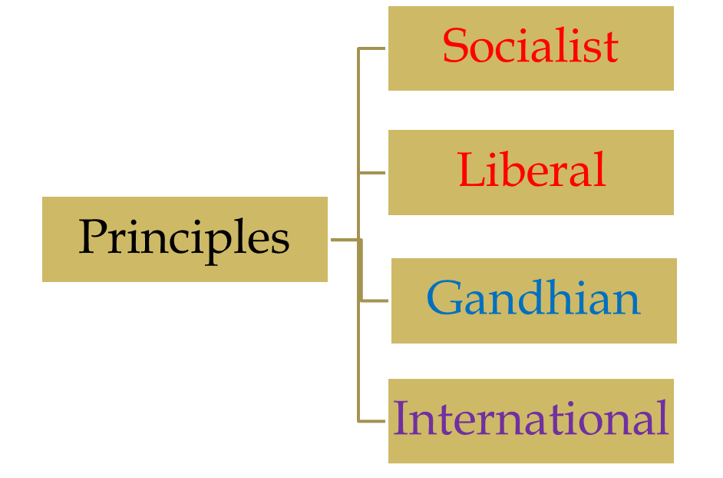
Socialist Principles
Liberal Principles
Gandhian Principles
International principles

Slide 5

Article 38 of the Constitution of India shall endeavour to formulate such social system which will secure social, economic and political justice to all in all the spheres of life.
Article 39(a) the state shall try to formulate its policy in such a manner so as to secure adequate means of livelihood for all its citizens.
Article 39(b) the ownership of material resources would be controlled in such a manner so as to subserve the common good.

Slide 6
Article 39(c) the economy of the state will be administered in such a manner so that wealth may not yet be concentrated in a few hands and the means of production may not be used against the public interest.
Article 41 of the Indian Constitution of the State will work within the limits of its economic viability and progress, provide to the citizens the right to work, the right to education and general assistance in the event of unemployment, old age, disease and other disabilities.

Slide 7
Article 42 of the Indian Constitution the state will make provisions for the creation of just and humane conditions of work. It will also ensure maternity relief.
Artcle 43 of the Indian Constitution the state will ensure adequate wages, good life and rest to the labourers. The state will also endeavour to make available to the labourers various socio-cultural facilities.

Slide 8

Artcle 44 of the Indian Constitution? The State shall endeavour to formulate and implement a Uniform civile-code for all the people livingthroughout the territory of India.
Artcle 45 of the Indian Constitution the State shall endeavour to provide early childhood care and education for all the children untill they complete the age of six years.
Artcle 47 of the Indian Constitution the State shall strive to raise the level of nutrition and the standard of living. Thus, it will endeavour to improve upon the health of the people.

Slide 9
Artcle 48 of the Indian Constitution, the State shall strive to organise agriculture and husbandary on modern and scientific lines. It will also try to maintain and improve upon the breed of the animals.
Article 50 of the Indian Constitution the state will try to separate the judiciary from the executive in the case of public service.

Slide 10

Article 40, State will strive to organise Panchayats in villages and will endow them with such powers which enabel them to act as units of self government.
Article 43, the state shall strive to develop the cottage industry in the rural areas both, on individual or co-operative basis.
Article 47,the state will strive to ban the consumption of wine, other intoxicating drinks and all such commodities which are considered injurious to health.
Article 48 reveals that State will ban slaughtering of cows, calves and other milch cattle.

Slide 11

Article 51(a)- The State will strive to promote international peace and security.
Article 51(b)- The State will strive to maintain just and- honourable relations among various states in the world.
Article 51(c)- The State will endeavour to promote respect for International treaties, agreements, and law.
Article 51(f)- The State will strive to settle international disputes by arbitration.

Slide 12

These are Non-justiciable
Not more than moral principles
No proper classification is done
Some Directive Principles are not practicable
These are foreign in nature
Against the principle of State Sovereignity
It is illogical to include these princciples in the constitution
These are responsible for Constitutional conflicts
No mention of methods to implement these

Slide 13

These Principles are directives for the States
Lay down the foundation of Economic Democracy
These are measuringf rods to judge the achievements of the Government
They establish welfare state
These are Fundamental in the Governance of the country.
These Principles supplement Fundamental rights
Guiding Principles for courts
They bring stability and continuity in State policies
Educative value of Directive Principles.

Slide 14

Constitution itself
Public opinion
Utility of Directive principles
Constitutional amendments
Laws made by the government
Executive orders

Slide 15

Avasthi, A.P, Indian Government and Politics, Narain Agarwal, Agra, 2001.
Fadia, B.L, Indian Government and Politics, Sahitya Bhawan Publication, Agra, 2002
Ghai, U.R, Indian Government and Politics, New Academic Publishing, Jalandhar, 2002.
Gupta, D.C, Indian Government and Politics,Vikas Publishing House, New Delhi, 1978
Johari, J.C, Indian Government and Politics, Vishal Publication, 1979.

